Slide 1
OCG – 12 Virtual meeting May 2021
Presenter: Hugh Roarty
Rutgers University
MARACOOS
Global HF Radar Network

Slide 2
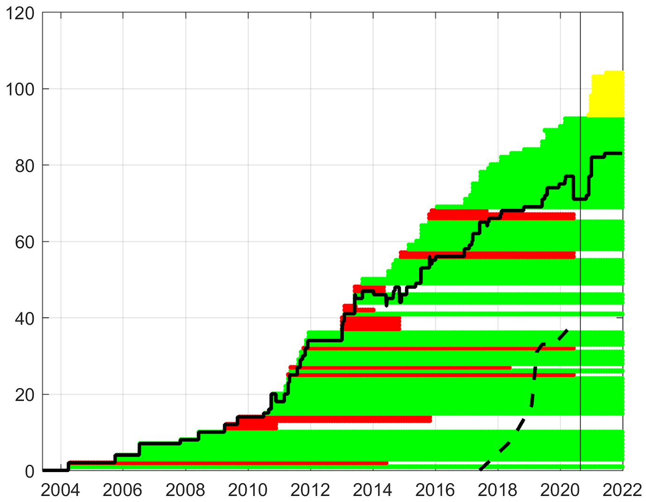
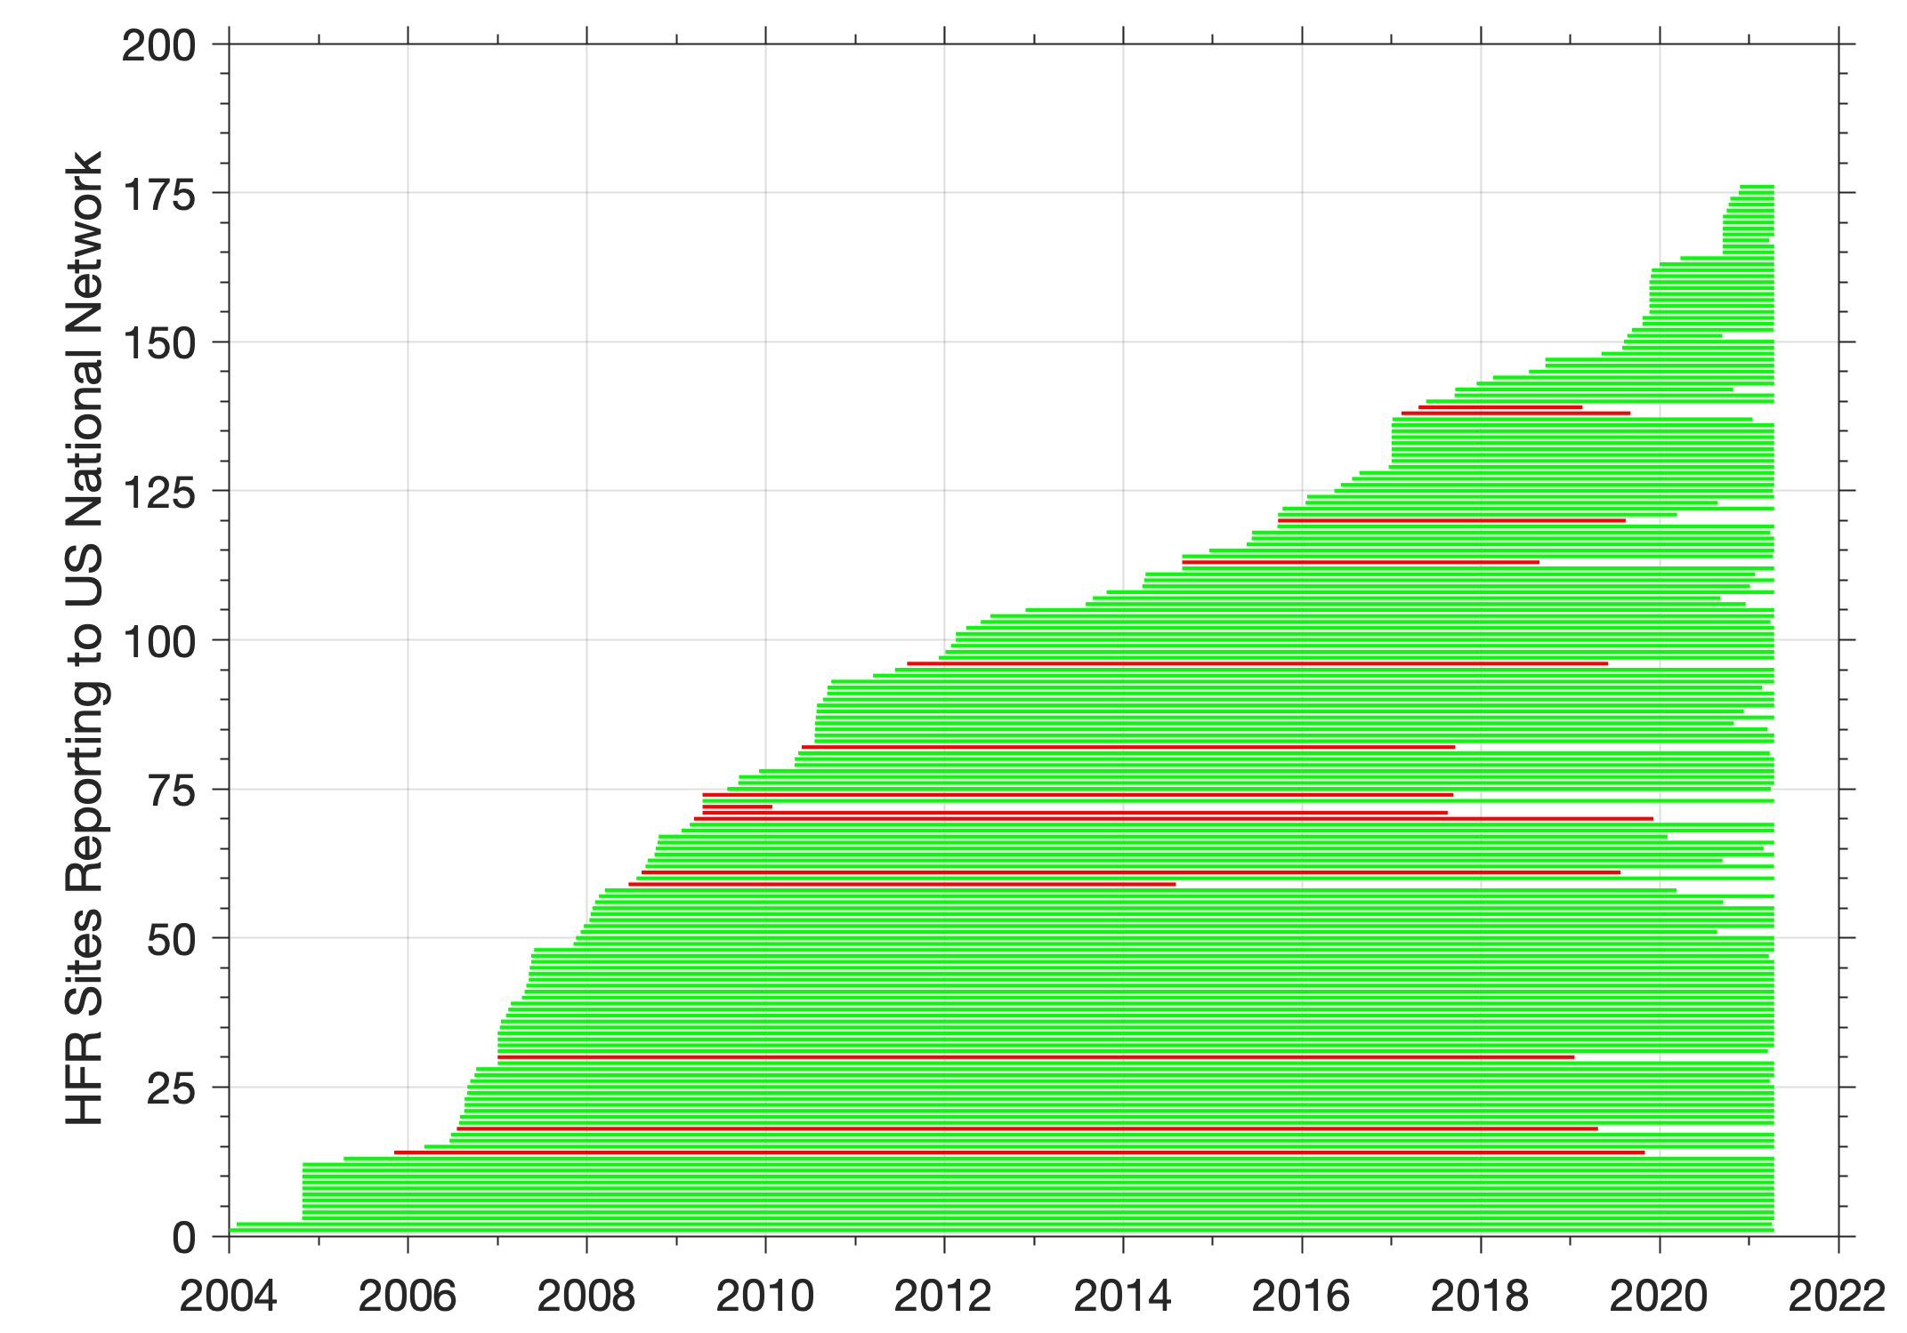
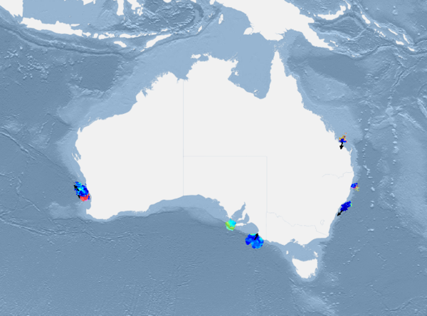
Coastal Surface Currents Network Overview
REGION 1
REGION 1
REGION 2
REGION 2
REGION 3
Sharing data on Internet
Not sharing data on Internet

Slide 3
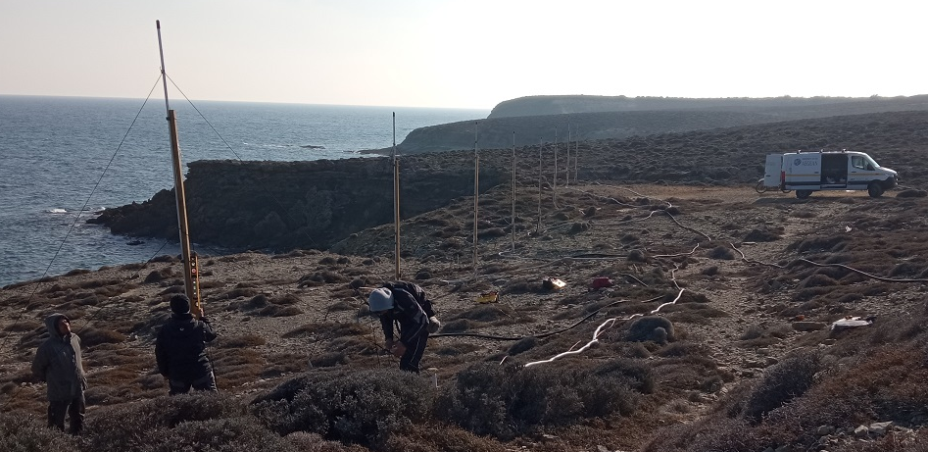
Developments and Achievements
New installations on the Iberian Peninsula, southwest and southeast of France, Ligurian sea in Italy upgrade and re-installation of two antenna sites east coast of Lemnos island, Greece
140 stakeholders identified within the European community
United States added 3 stations and planning first operational freshwater HF (41 MHz) radar system in September 2021, Canada added 1 station.
Emerging products: waves, eddy identification
Taiwan, China preparing for deployment of 12 phased array systems and 15 X-band ocean radars focused on monitoring ocean waves and currents
Thailand is concluding Phase 2 (2016-2021) of their HF radar buildout plan which brings the number of operating stations to 24
IMOS has made major efforts to install new HFR systems along the northwest shelf, Ningaloo
Cahl/SECOORA
Eddy Identification
Taiwan, China
WERA Rx Plaka, Greece

Slide 4
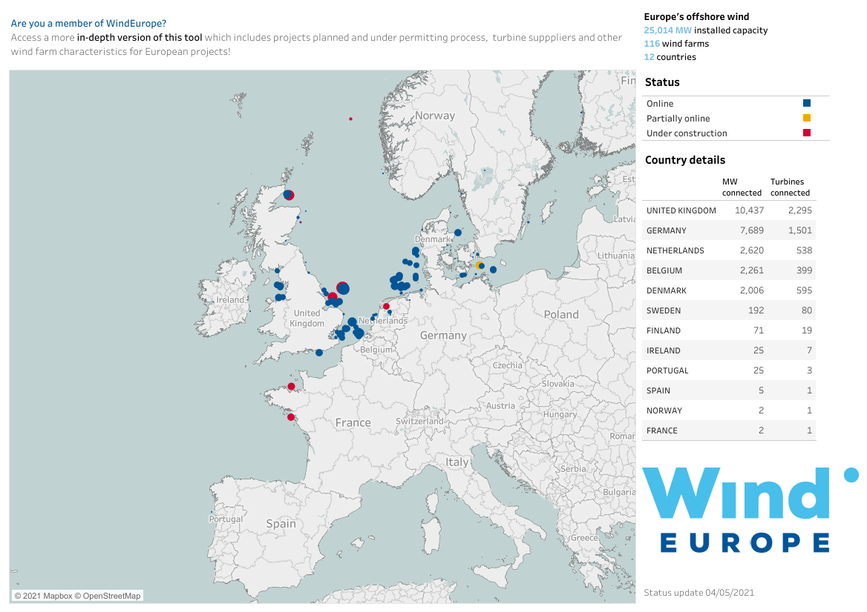
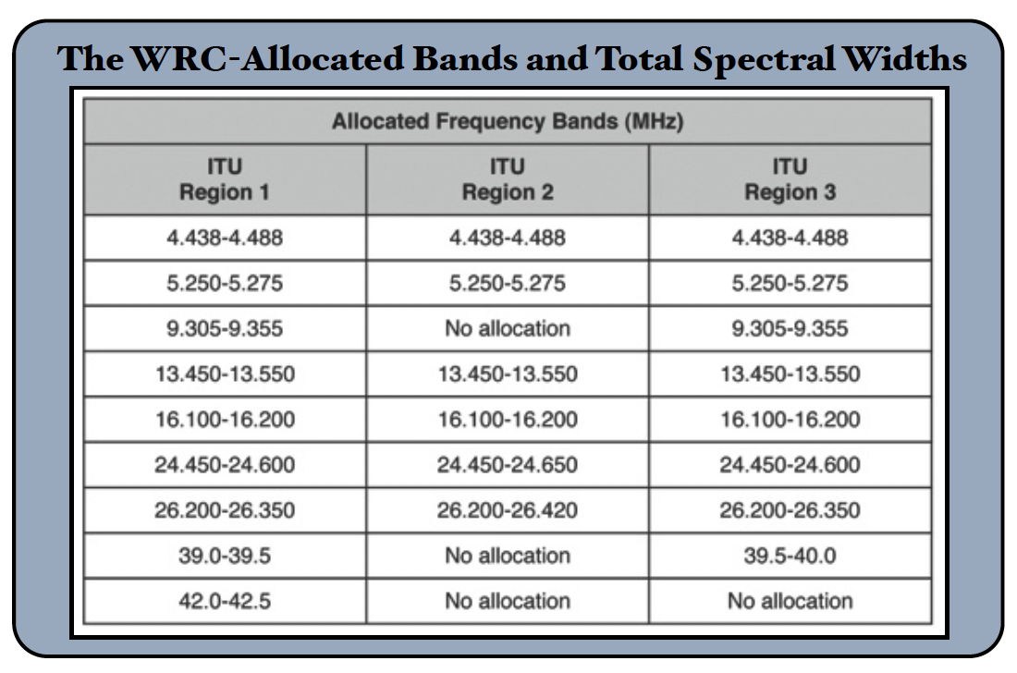
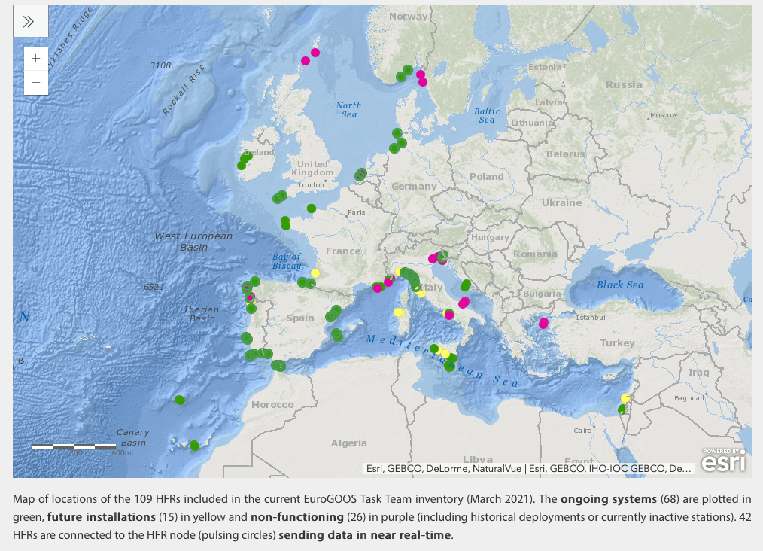
Challenges and Concerns
Transition to ITU frequency bands
Developing new products while maintaining existing ones
Offshore wind development
HF Radar Stations

Slide 5
Future Plans and Opportunities
Continue discussions with Ocean Best Practices to finalize community approved HF radar best practices
Begin discussions with Ocean Ops to define metadata standards for the delivery of data to national and global data assembly centers.

Slide 6
Attribute Report out
 | Global in scale
 | Observe one or more EOV or ECV
 | Observations are sustained
 | Community of Practice
 | Maintain Network Mission and Targets
 | Delivers data that are free, open and in a timely manner
 | Ensures metadata quality and delivery
 | Develops and follows Standards and Best Practices
 | Undertakes capacity development and technology transfer
 | Environmental stewardship awareness
Good
Satisfactory
Needs Improvement

Slide 7
Asks from OCG
Guidance on how to encourage operators from Region 3 to share data from their networks?
How to develop central repository for Region 3?

